Slide 1
Drury Explorer
High level Inception

Slide 2
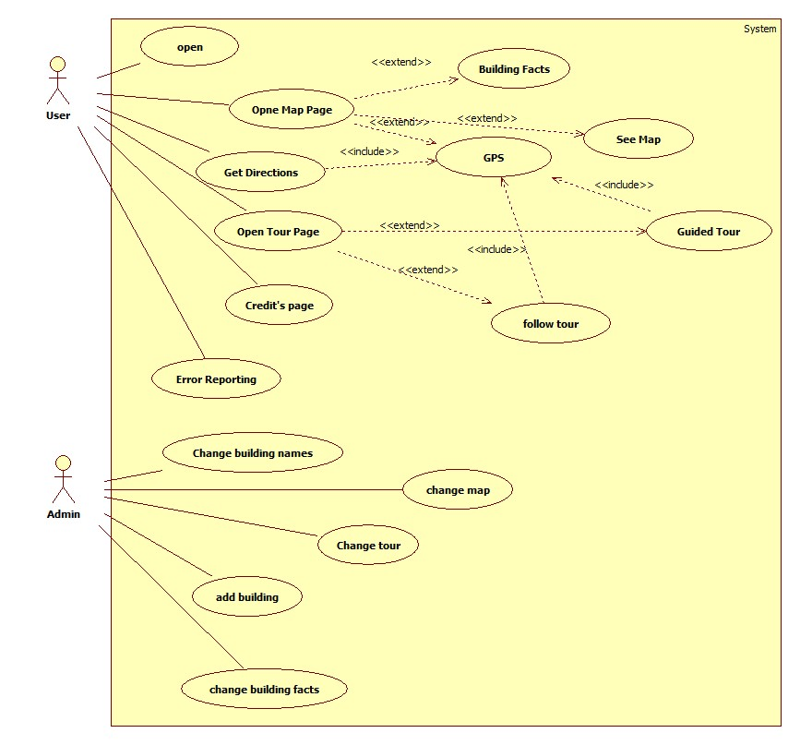
Use Case and Meeting

Slide 3
Risk Analysis
Where do we keep the database after deployment?
Who will maintain the app (keep info up to date, add/remove buildings)?
Learning the Android architecture.
How to keep records of student appointments?
What is the possiblity/difficulty of porting from Android to Apple?
Apple style apps are "fresh" but will it hold up on Android?
Accuracy of phone GPS (REALLY BAD at pinpointing exact location).

Slide 4
Technology Plan
Google maps
MySql
SQLite
Android SDK
Appery.io
Phonegap
Appmakr
App inventor for android
Appcelerator and titanium
Android Studios

Slide 5
Cost analysis
5 person months for our group

Slide 6
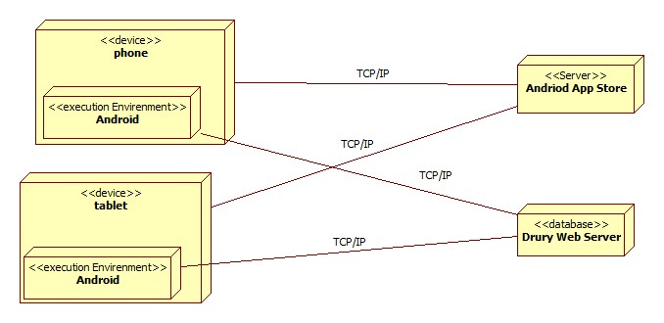
Deployment Model

Slide 7
Sprint 1 Inception: Who
Daiv-Use Case Diagram, Deployment Model
Josef-isolate tech plan and establish tech training plan
Daniel-Cost and Risk analysis

Slide 8
Sprint 1 Inception: What
Josef - Begin with refined tech plan and train on the technologies
Daniel - Learn technologies and start with mock designs
Daiv - Continue contact with client and learn technologies

Slide 9
Sprint 1 Inception: When
2 Days

